Slide 1
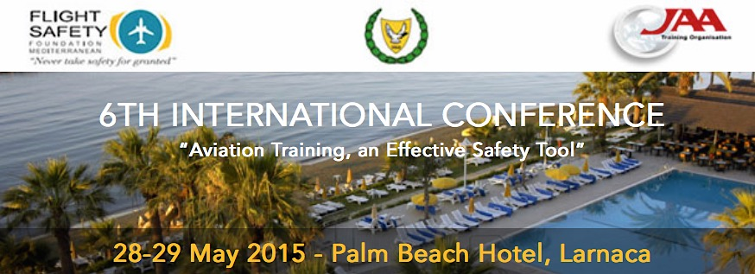
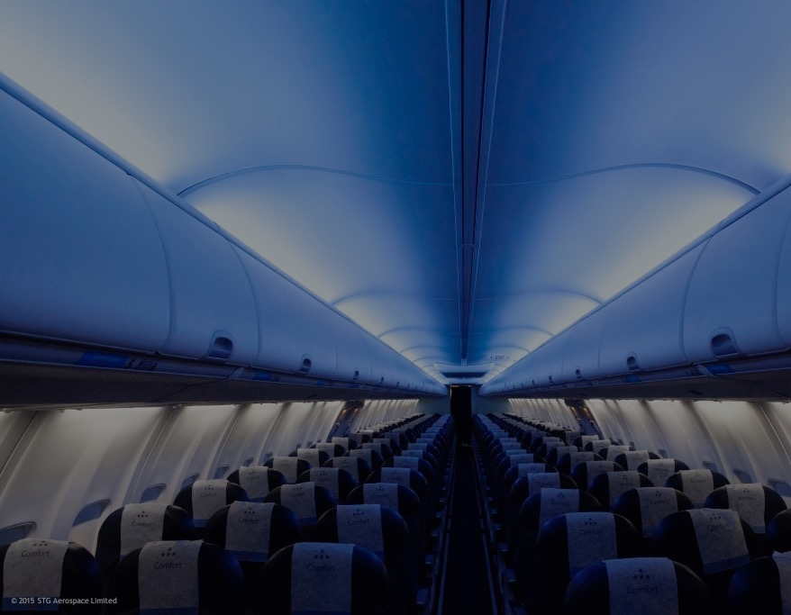
Notes:
Good morning Ladies and Gentlemen,
A warm welcome to all of you at this 6th Conference of the FSF Mediterranean on Training and Safety, for which about 170 participants have registered.
My name is Erik Merckx, and I will be your Chairman for this Conference
Welcome to sunny Cyprus, and sunny Larnaca in general. For those for whom it is the first time to visit Cyprus, I would say: take this opportunity if you do have the time to go around, it is a beautiful island with very pleasant people and a most enjoyable atmosphere.
The FSF-Med The“ Flight Safety Foundation- Mediterranean ( FSF-MED ) “, was established in 2008 in Cyprus as a non-profit and non- Governmental Organisation. FSF-MED is an affiliated Institution of the International Flight Safety Foundation based in Washington. Its main objective is to contribute to the enhancement of aviation safety , to facilitate training in aviation issues, to encourage the adoption of global and European aviation policies and to foster cooperation between the countries of the Mediterranean and Middle Eastern regions. FSF-MED signed Memoranda of Co-operation ( MOC) with the “Russian Flight Safety Foundation” , the “Romanian Aerospace Association”, the “ Fisher Institute” of Israel and “the ICAO European Office”. In addition it maintains close relations with the European Commission, EUROCONTROL, ERA , EASA and other international bodies. All involved in FSF-MED work on a voluntary basis. The small budget is financed by grants from the Ministry (HERMES Airports, CYTA, CTC Ari and some other organisations). The grant by the Ministry is provided on the basis of an MOC signed 5 years ago and which needs to be renewed this year. FSF-MED has already organized a number of International Conferences and Seminars, with participants and speakers from several countries and Organisations, such as the Secretary General of ICAO, the President of ECAC, the Executive Director of EASA, high ranking officials of EUROCONTROL, the Presidents of IFATCA and IFALPA, the CEO of AEA and ERA, and many others.

Slide 2
Notes:
This conference is a joined activity with the Joint Aviation Authorities Training Organisation, and with the strong support of the Government of Cyprus. Therefore I would like to thank already now the JAA, particularly Joost Jonker, the director of the JAA TO, as well as the Government of Cyprus, represented today by Mr. Alecos Michaelides, the Permanent Secretary of the Ministry of Communications and Works, for all their effort it making this happening, particularly during times that resources are very scarce.
I also like to thank already now Christos Petrou, CEO of the FSF Mediterranean, for all the preparation to turn this into a success, and Mr. André Auer, Chairman of the organizing committee.
The objectives of this Conference are stated in your programme, but they are worth repeating here during the opening session :
What we want to achieve is sharing of information in the field of civil aviation training, sharing ideas, raising issues and offering practical solutions on the way forward to improve safety through training, both initial training as ongoing training. Of course, a conference like this is always a unique opportunity for networking with the experts in the field, and I am sure you will do that over the next few days.
I strongly believe that the timing of this conference is spot on. Never has training, and its impact on safety, been so important as today. I am therefore very proud to inform you that the conclusions of this conference, that we will put together based on your input and our discussions, will be presented to ICAO, to ensure that suggestions made here are not lost and can be taken up in a wider global context.
You will have looked at the programme, and I am certain that you will agree with me that we have an excellent team of speakers and a good selection of topics. After each session, there will be the possibility to ask one or two burning questions; however please note that there will be a Q&A session at the end of the day today.
I would like introduce to you the people on the table here : ….
Ladies and Gentlemen, let’s start ! I hereby declare this 6th Int. Conference opened.

Slide 3
Global commercial aviation 2015
> 100,000 flights/day
38 million flights/year
3.3 billion passengers/year
Value of $ 2.5 trillion
50 million tons cargo/year
60 million jobs
Sources: IATA, Airbus, Boeing, ICAO, ACI
Notes:
Ladies and Gentlemen,
I would like to open this conference by highlighting a few topics on training and safety, at least as I see them.
Before doing so however, we need to look at some aviation figures.
I think we are all familiar with what the European business figures are, so let us focus on the global commercial aviation figures as they stand today.
At the end of last year, or beginning of 2015, we passed an impressive total of 100,000 flights per day.
That means 38 million flights per year, transporting 3.3 billion passengers worldwide.
The global aviation business is calculated to have a value of 2.5 trillion American dollars
We also transport 50 million tons of cargo per year
And last but not least our business ensure worldwide 60 million jobs

Slide 4
Global commercial aviation 2015
22,000 aircraft in service
240,000 airline pilots
2500 airports
50,000 Air Traffic Controllers
275 Area Control Centers
… million of maintenance engineers, technicians, cabin crew, ground crew, etc.
Sources: IATA, Airbus, Boeing, ICAO, ACI, IFATCA
Notes:
What do we have in place today to arrive at these impressive figures ?
Well, at the moment, is is believed that we have something between 21,000 and 24,000 commercial jetliners in service; these figures come mainly from Airbus, Boeing and IATA. I have taken an average of 22,000.
In order to fly these 22,000 a/c we have currently 240,000 commercial transport pilots…
… which land worldwide at about 2500 airports, of which 1000 of them make about 90% of the traffic, and the 100 top-airports make about 60% of the traffic.
Further on the ground, we have 50,000 ATCO’s worldwide (that is what IFATCA states)
275 Area Control Centers
And a few million – I do not know the exact figure – of maintenance engineers, technicians, cabin crew, ground crew, airport staff, regulators, auditors, managers, …..

Slide 5
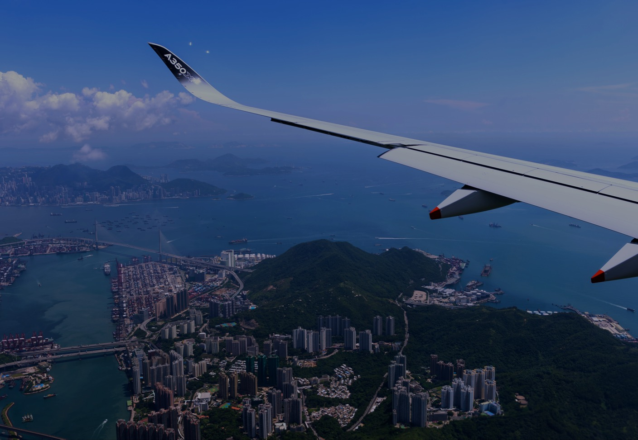
Global commercial aviation 2015
Safety: Airliner Accidents
Safety: Airliner Accidents
Source: Aviation Safety Network (Flight Safety Foundation)
Source: Aviation Safety Network (Flight Safety Foundation)
Notes:
What about safety around the globe ?
There are many different statistics on the number of accidents, accident rates etc., and the reason why they are different is because they all have different assumptions (MTOW, civil and/or civil plus military, origin of a/c manufacture etc. )
However, in every one of these statistics, we see that accidents are going down
This one is produced by the FSF, and shows absolute accidents for every commercial a/c with at least 12 seats
2014 was the safest year ever, on average, around the globe
So, in spite of growing traffic, the industry has made and is continuing to make significant efforts to make flying safer

Slide 6
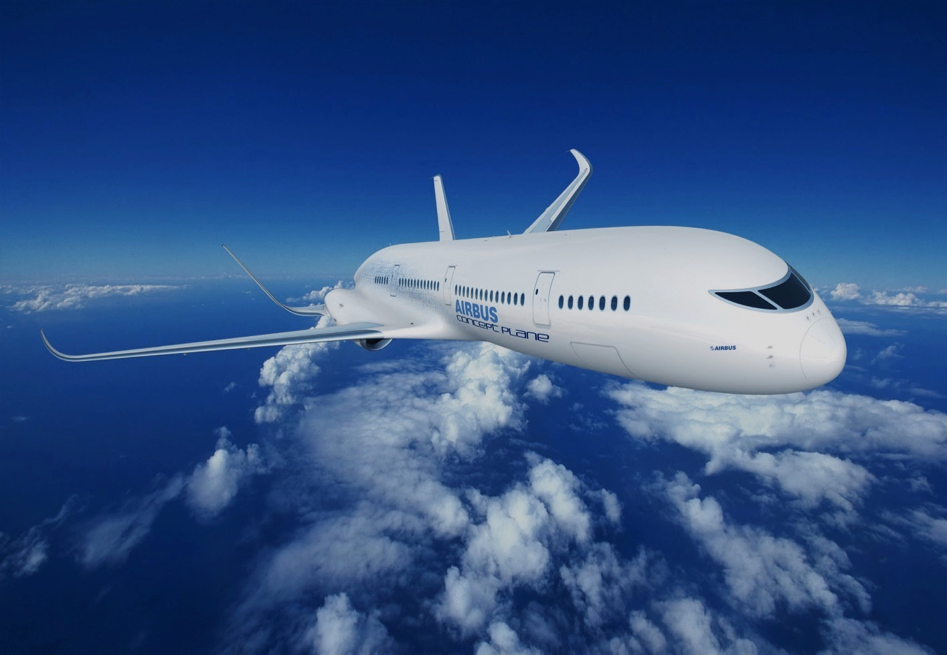
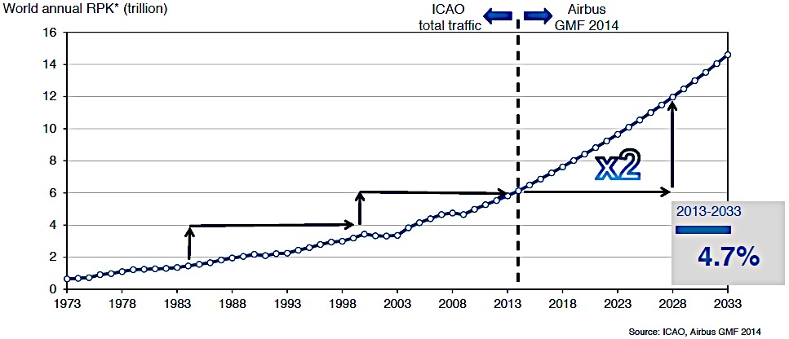
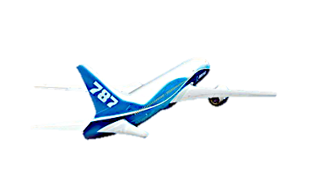
Global commercial aviation 2033
Traffic doubles every 15 years
Notes:
Now that we covered the situation as it is today, what will the future bring us, say in 2033 ?
I would like to show you a traffic forecast graph, produced by Airbus ( but honestly, the figures from Boeing are not that much different)
Airbus observes that in the past, until 2014, traffic has been doubling every 15 yrs.
So for example, between 1983 and 1998, traffic doubled from 1.5 RPK to 3 RPK (1)
From 1998 to 2013, another 15 years, it doubled again from 3 RPK to 6 RPK
The latter is surprising, because we have seen during the last 15 years quite some adverse effects: 9/11, bird flu, oil prices, airline bankruptcies, … : it shows however how resilient aviation business is and how well it recovers
Airbus therefore concludes that, if traffic doubled every 15 years in the past, there is no reasons why it should not double in the future: from 6 RPK to 12 RPK by 2028, and nearly 15 RPK by 2033
This forecast is believed to be realistic, mainly because it is supported by a huge growth in Asia : not only in countries like China and India, but also in south-east Asia, such as Indonesia and the Philippines.
(1): Revenue passenger kilometers (RPK) is a measure of the volume of passengers carried by an airline; a revenue passenger-kilometer is flown when a revenue passenger is carried one kilometer. A passenger for whose transportation an air carrier receives commercial remuneration is called a revenue passenger. This excludes passengers travelling under fares available only to airline employees and babies and children who do not have a seat of their own. The RPK of an airline is the the sum of the products obtained by multiplying the number of revenue passengers carried on each flight stage by the stage distance - it is the total number of kilometers travelled by all passengers. RPK is a measure of sales volume of passenger traffic.

Slide 7
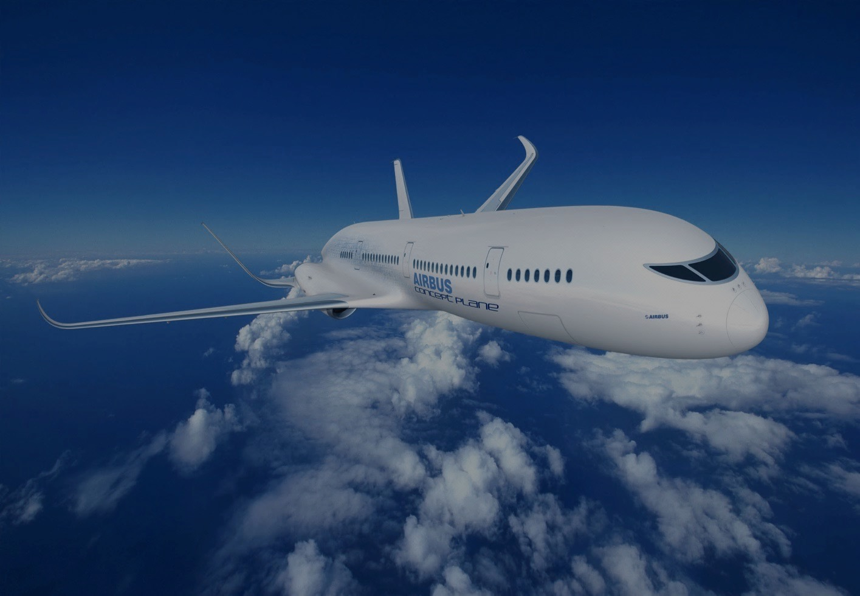
Global challenges 2033
2030 - -
2030 - -
2030 - - 40,000
+ 580,000
+ 530,000
2015 - - ?
2015 - - 22,000
2015 - - 240,000
Notes:
If one believes those traffic forecasts, what are then the consequences for what we need to deliver them ?
First, how many a/c will we need by 2033: the double of today, ca. 40,000 (at least 60% of them single aisle a/C, type A 220): this is the easy bit, both Boeing and Airbus believe this is manageable
But now, who will fly them ? It is calculated that we will need more than 0,5 million additional pilots
Of course, these a/c need to be inspected, serviced, maintained, repaired: that makes another, over 0.5 million technicians and engineers
These are just the two most safety critical jobs in the airlines; we don’t even mention all the other additional recruitment
So, this makes 1.1 million people. In order to put this in perspective, this is like converting the entire population of Greek-Cypriots here in Cyprus into pilots and technicians !

Slide 8
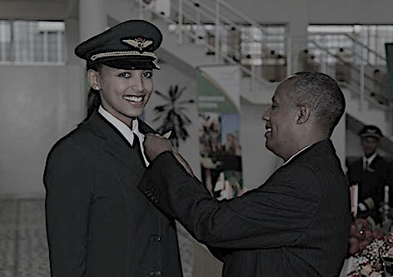
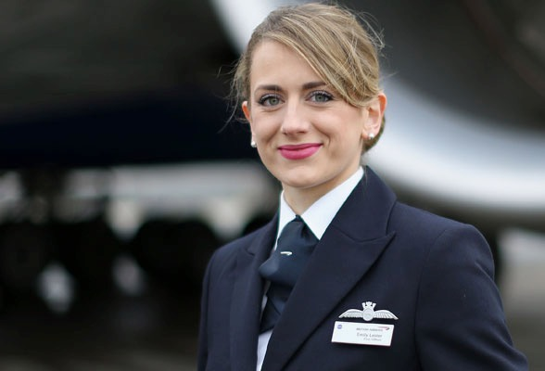
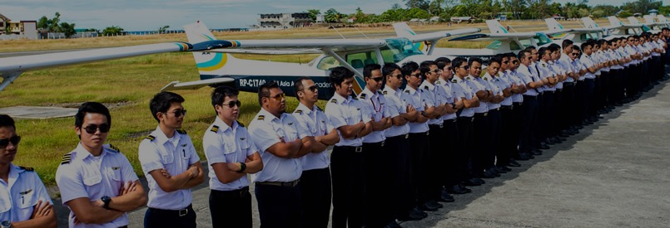
Training and safety challenges 2033
Maintaining or improving levels of safety:
Pressure on solving recruitment and training needs
Issue on flight automation vs. manual flying skills
Global interchangeability of training knowledge and experience
Notes:
Let’s now look at some of the safety issues we might expect, and their relationship with training.
There might be many, but I would like to focus on 3 of them, which at least in my view are important for the future.
I will discuss each of them one by one, but this is the summary.
What is the effect on safety resulting from the pressure to recruit fast, and train very fast new pilots and technicians ?
Aircraft are becoming more and more flying robots: who flies the aircraft ?
Is pilot training knowledge and experience interchangeable ? I will explain you what I mean by that

Slide 9
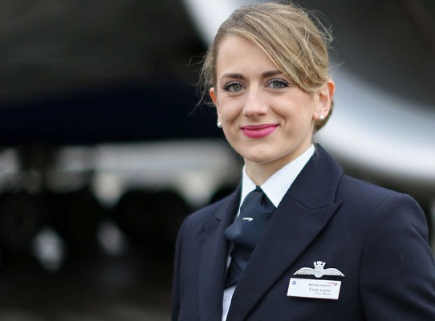
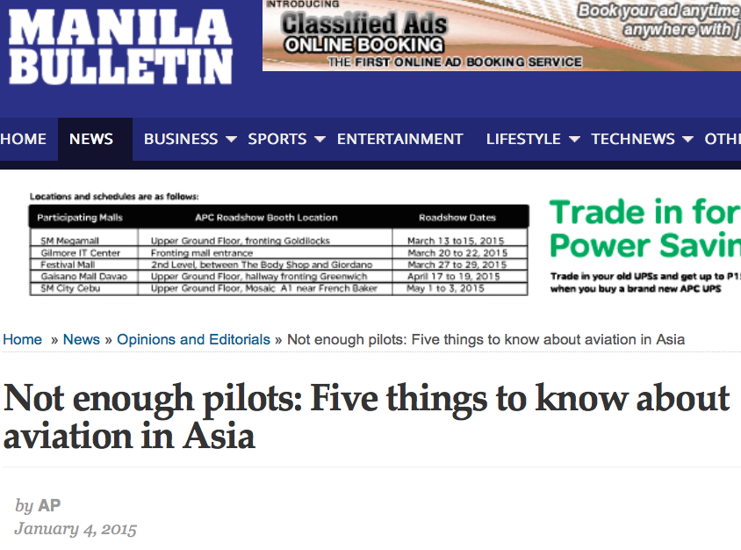
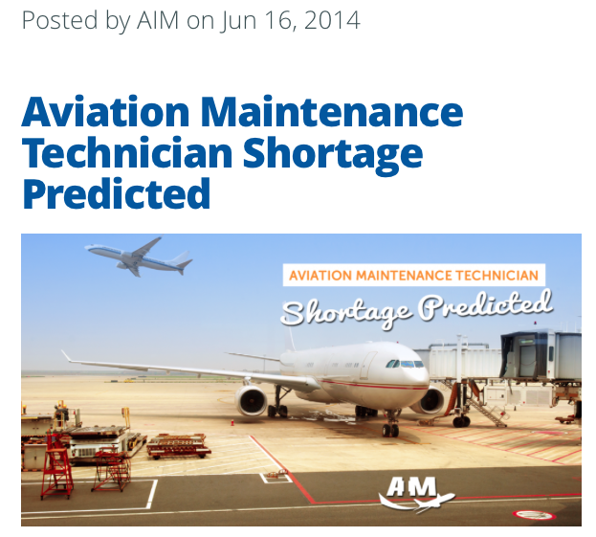
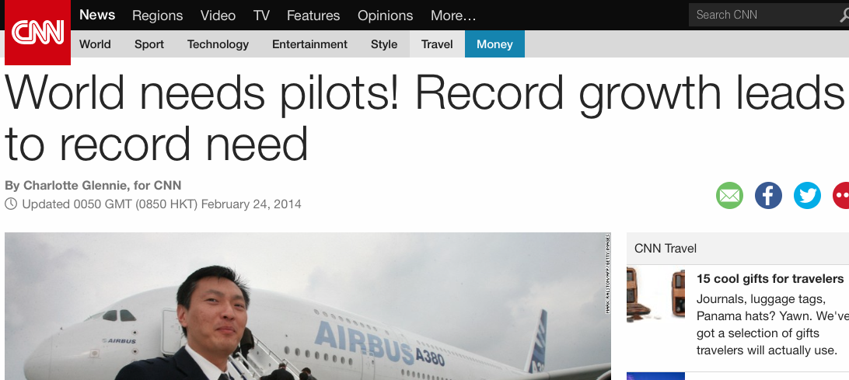
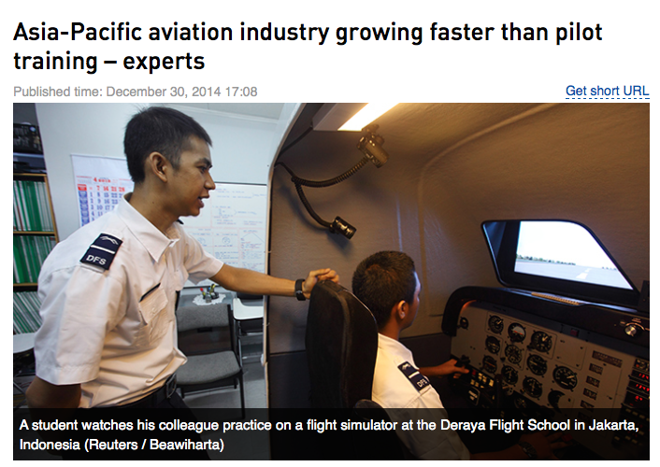
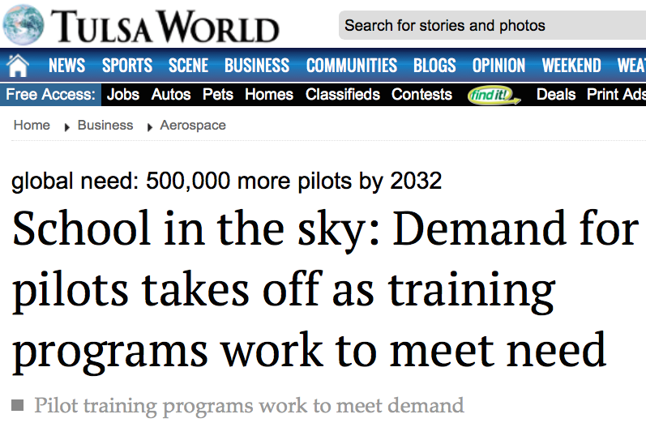
Training: pressure to train many more pilots
Notes:
Here a selection of articles on the predicted future shortage of pilots and technicians.
There is an underlying opinion that there are not enough training instructors available to meet the demand
There will be – as always – a commercial pressure to recruit and train new pilots anyway, and shortcuts will probably be found
Will that mean even more hours on the simulator, and even less in real flying ?
With the pressure to deliver many graduates, in the fastest way possible, is the quality of ab initio and type rating training going to be the same as today ?
Will the regulator be capable of handling the extra work of licensing and maintaining licenses ? In other words, is the regulatory oversight going to be sufficient ?
In summary, is safety going to be comprised ? Or do we believe that it is going to be OK ?
I think this is food for thought.

Slide 10
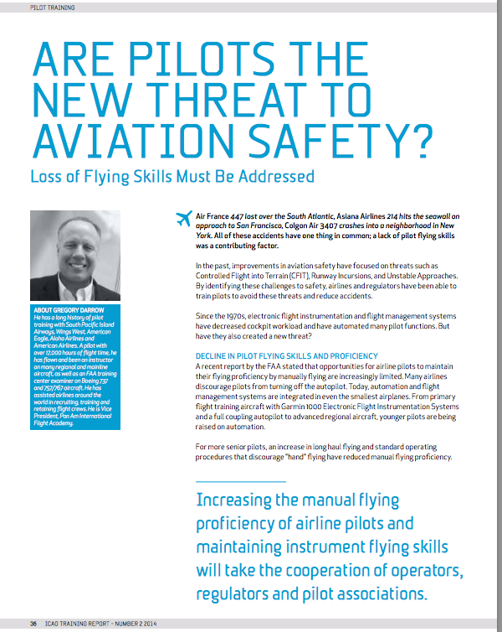
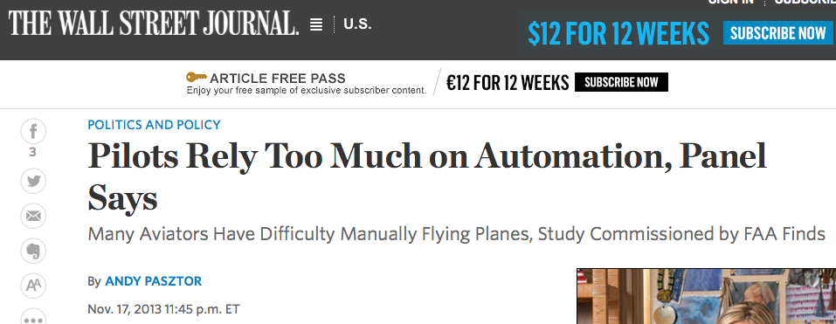
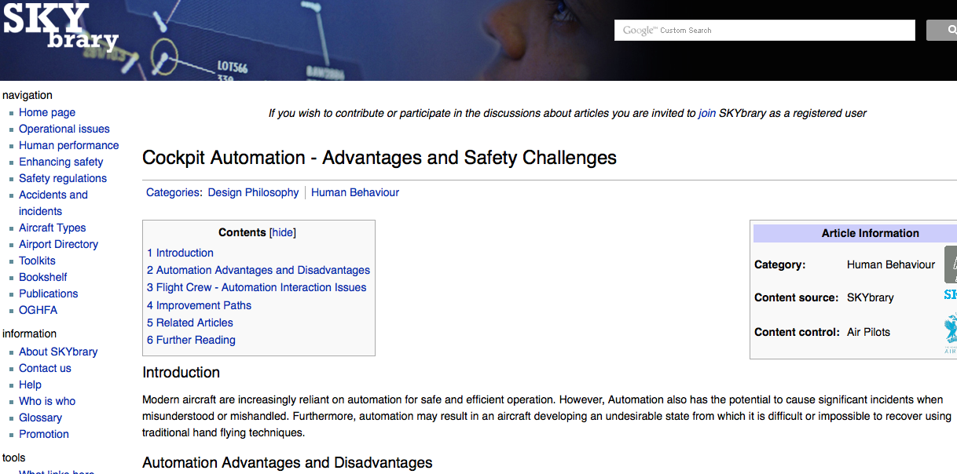
Training: Flight automation vs. manual flying skills
Notes:
A second topic that does not go away is the debate on the desired level of automation and the manual flying skills of a pilot.
Analysis of accidents and incidents show that pilots do rely heavily on the automation in the cockpit, to the extent that, when an event arises where they have to react quickly, take over from automation, take the right decision and fly manually.
Here are a number of articles on the subject.
I hope that this topic will in one way or the other be tackled during this conference.
This issue is of course related to the previous one: more automation is a means of speeding up training of new pilots …

Slide 11
Training: interchangeable experience
Notes:
My last issue is a difficult one, because it is one that is hidden underneath the surface. It is about interchangeability of training knowledge and experience.
Let me tell you first of all a little story that I experienced, and which has nothing to do with aviation ….
Now, let’s go back to the Überlingen accident, more than 10 years ago, and have a look at the way looked at TCAS in those days….
My point is that in most of the cases, a pilot that has been to training school A and has flown for a certain airline on a certain type of a/c, will be having the same knowledge and experience as a pilot that has been to training school B, flying now also for (another) airline on an aircraft of that type. Some of you may say, in 95% of the cases, maybe even 98%-99% of the cases, experience and knowledge will be the same. I agree, but it is the remaining 1%-2% that causes the accidents, as we see when we analyze our accidents. In a world with a growing need for more pilots, we can not afford that we miss out on this 1%-2% different type of experience. Therefore I welcome the debate we will have on the following school of thought: is there a need of having a kind of global association for training, that exchanges good practices, can formulate advise etc.

